Slide 1
RAMAIAH
INSTITUTE OF TECHNOLOGY
AI-BASED BREAD QUALITY
INDICATOR SYSTEM
Dept. of Electronics &
Instrumentation Engineering
GROUP MEMBERS
Samay Thakur (1MS23EI044)
Vinod Naik (1MS24EI404)
Naveen L (1MS23EI034)
Subham Kumar Singh (1MS23EI053)
EIP-67 MINI PROJECT
GUIDED BY: Dr. M K Pushpa, Dept. of EIE
Academic Year: 2026–27

Slide 2
CONTENTS
1
Problem Statement
8
Software Components
2
Objectives of the Project
9
Software Implementation & Code
3
Scope of the Project
10
Software Implementation & Code( WEB APP)
4
Literature Survey
11
Results & Performance
5
Block Diagram
12
System Behaviour
6
Hardware Components
13
Conclusion
7
Hardware Implementation
14
References

Slide 3
PROBLEM STATEMENT
⚠ Manual Inspection Fails
🦠 Invisible Contamination
Traditional spoilage detection relies on visual checks by humans, missing early-stage mold or invisible toxic gases.
Gases released during the initial bread spoilage are not detectable .
💸 Food & Economic Loss
🏥 Health Risks
Households, bakeries, and supermarkets suffer losses when spoiled bread is not detected in time.
Consuming spoiled bread can cause health issues such as food poisoning and respiratory problems.

Slide 4
OBJECTIVES OF THE PROJECT
01
Develop a real-time system to detect bread spoilage using ESP32-CAM and MQ135 gas sensor.
02
Analysis of bread spoilage using image base detection with the help of trained kagggel dataset
03
Detecting gas levels released during bread spoilage using MQ135 sensor.
04
Use threshold-based logic to classify bread as fresh or spoiled.
05
Provide visual (LED) and audio (buzzer) alerts when spoilage is detected.

Slide 5
SCOPE OF THE PROJECT
Target Bread Type
Detection Methods
Deployment Context
White bread — most commonly found in households, bakeries, and supermarkets.
Gas sensor-based spoilage detection using MQ135 with reference to image-based analysis.
Standalone alone device
Environment
Alert Mechanism
Suitable for indoor storage areas: kitchens, pantries, bakery counters.
Red LED , buzzer on for spoiled bread.
Green LED ,no buzzer for good quality bread.

Slide 6
LITERATURE SURVEY
Reference
Title of the Work
Objective / Gap Addressed
Key Result
1
P. Warden et al., “TensorFlow Lite Micro for Embedded AI on ESP32,” IEEE Embedded Systems Letters, Vol. 12, Issue 4, 2020
Deploy lightweight AI models on low-power embedded systems for real-time bread quality classification
Demonstrated that ESP32 can run optimized ML inference with low memory and power consumption for edge AI applications
2
S. Lee et al., “MQ Gas Sensor-Based Food Spoilage Detection System,” IEEE Sensors Journal, Vol. 21, Issue 8, 2021
Detect spoilage gases such as ammonia, VOCs, and methane emitted from stale or moldy bread
MQ-series sensors successfully identified spoilage conditions using gas concentration thresholds in real time
3
A. Kumar et al., “CNN-Based Mold Detection in Food Products,” IEEE Access, Vol. 9, Paper ID 145632, 2021
Improve visual inspection accuracy of bread using AI image classification techniques
CNN models achieved high accuracy in detecting mold growth and surface contamination from captured images
4
H. Zhang et al., “CNN-Based Detection of Moldy Bread Using Deep Learning Image Classification,” IEEE Access, Vol. 10, Paper ID 118742, 2022
To develop an AI-based CNN model for early detection of mold growth in bread using microscopic image classification and deep learning techniques.
The CNN model achieved near-perfect detection performance with F1-scores of 0.9948 for white bread and 0.9972 for whole wheat bread, enabling accurate early-stage mold detection.
5
J. Patel et al., “IoT-Based Smart Food Quality Monitoring System,” IEEE Access, Vol. 9, Paper ID 98745, 2021
Real-time monitoring systems
Improves food quality monitoring and reduces spoilage

Slide 7
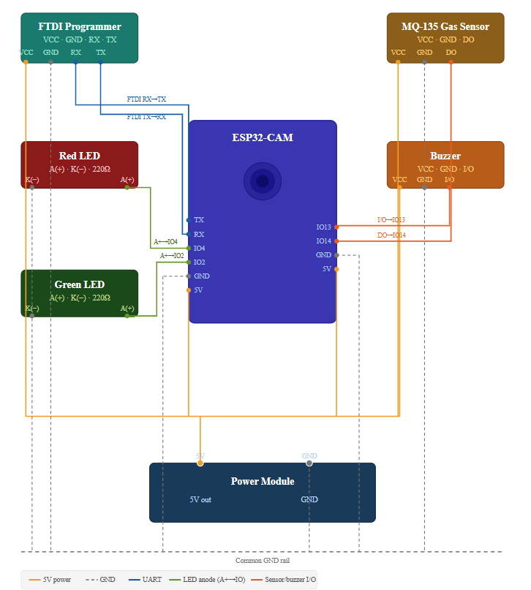
BLOCK DIAGRAM

Slide 8
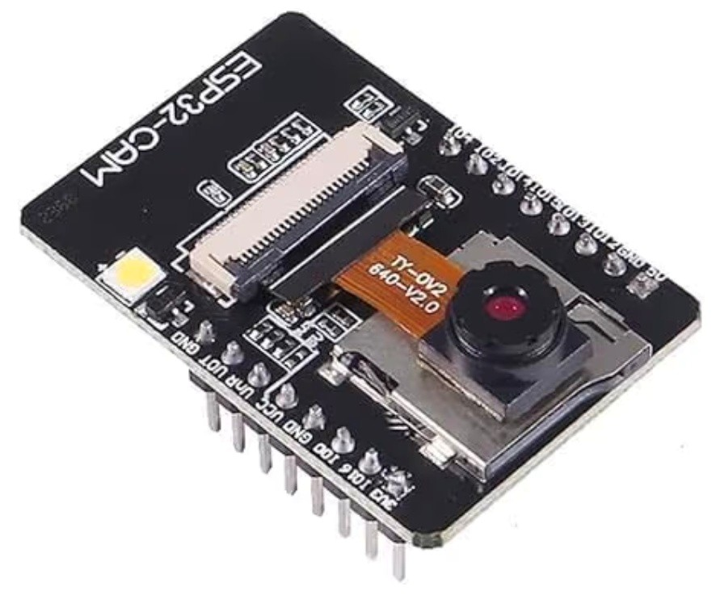
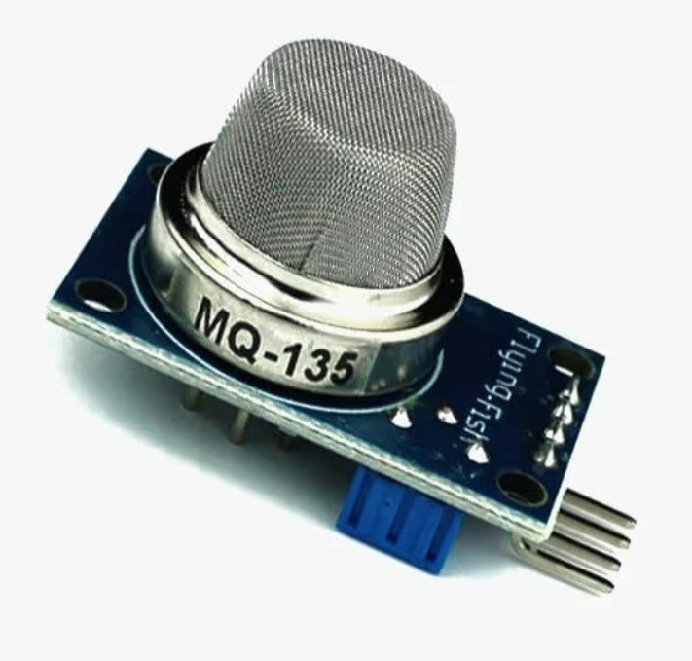
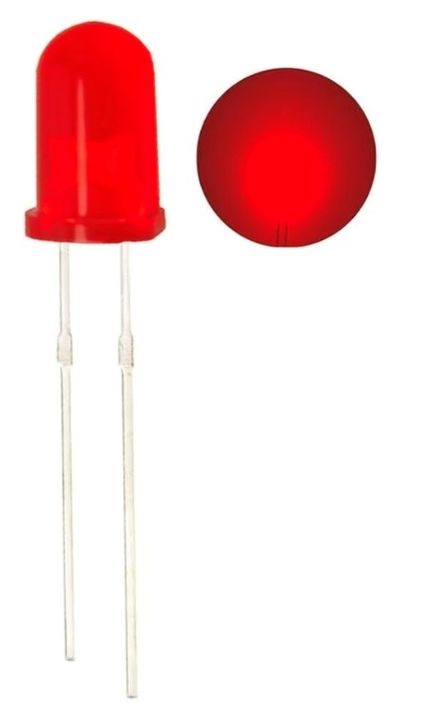
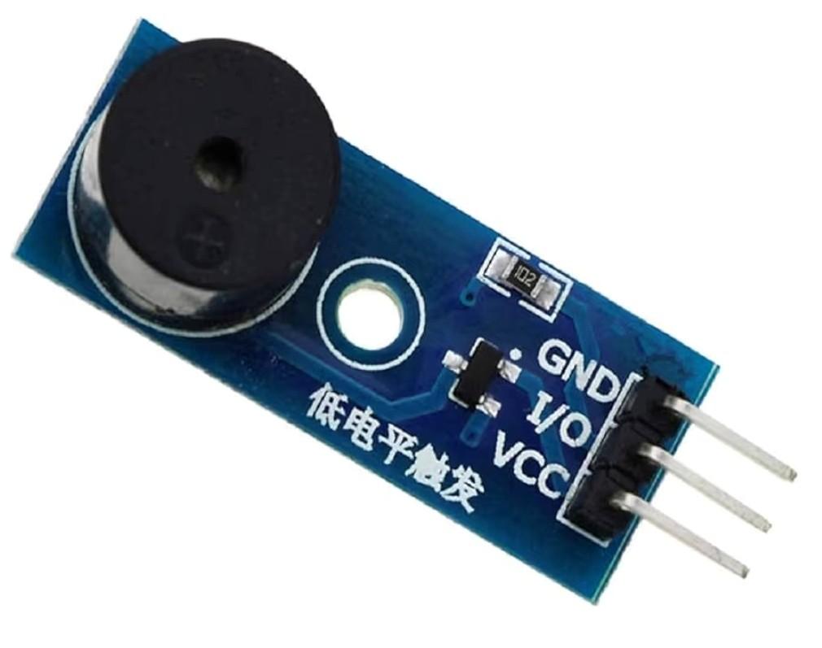
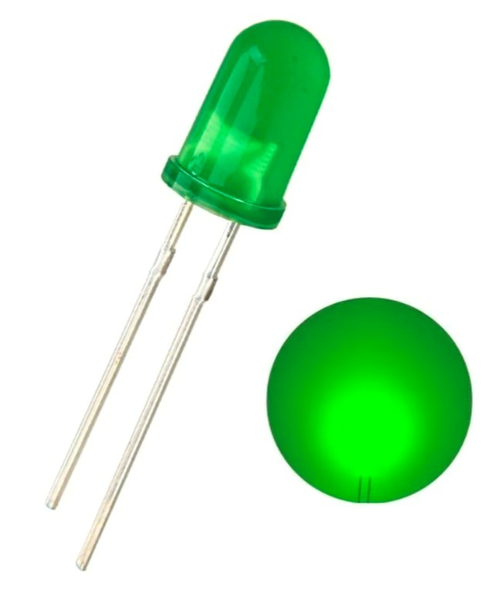
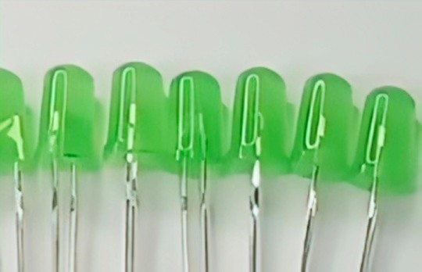
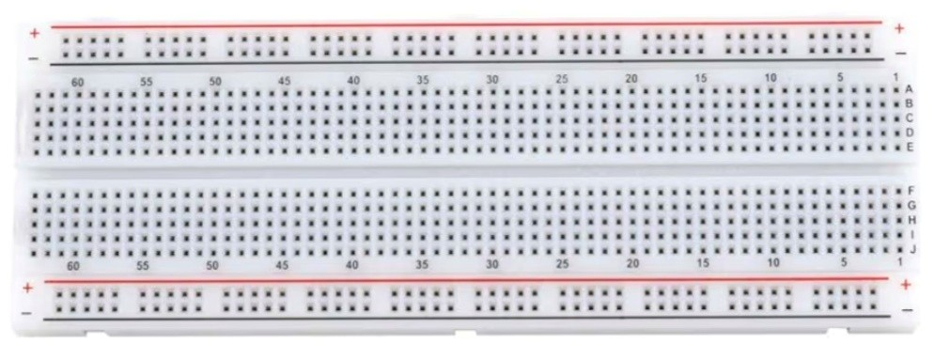
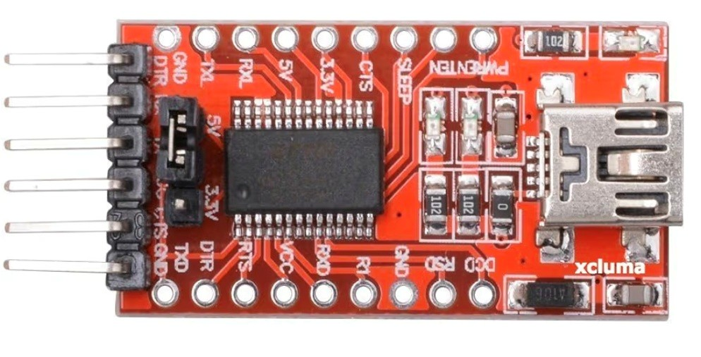
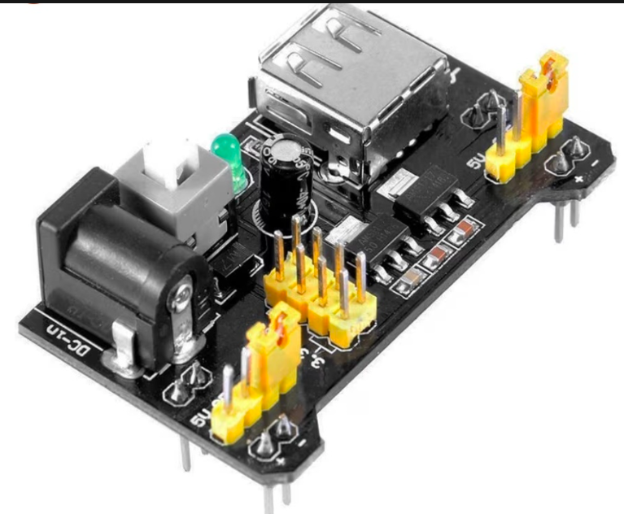
HARDWARE COMPONENTS
ESP32-CAM
MQ-135 Gas Sensor
Central controller + image capture
240 MHz dual-core, 520 KB SRAM, OV2640 2MP camera, Wi-Fi + BT, 4MB flash
Detects NH₃, CO₂, NOx, benzene; analog output 0–5V; sensitivity adj. via potentiometer
Gas spoilage detection
Active Buzzer
Red LED
5V active buzzer, 85 dB, continuous tone on HIGH signal
Audible spoilage alert
5mm red LED, 2V forward voltage, 10 mA max
Green LED
Breadboard + Jumper Wires
5mm green LED, 2V forward voltage, 10 mA max
Visual freshness indicator
830-point breadboard; male-to-male + female-to-female jumper wires
Prototyping & connections
FTDI Programmer
Power Module-MB-102
USB-to-serial converter for programming ESP32-CAM (no built-in USB)
Firmware upload
5v supply from the power source
System power

Slide 9
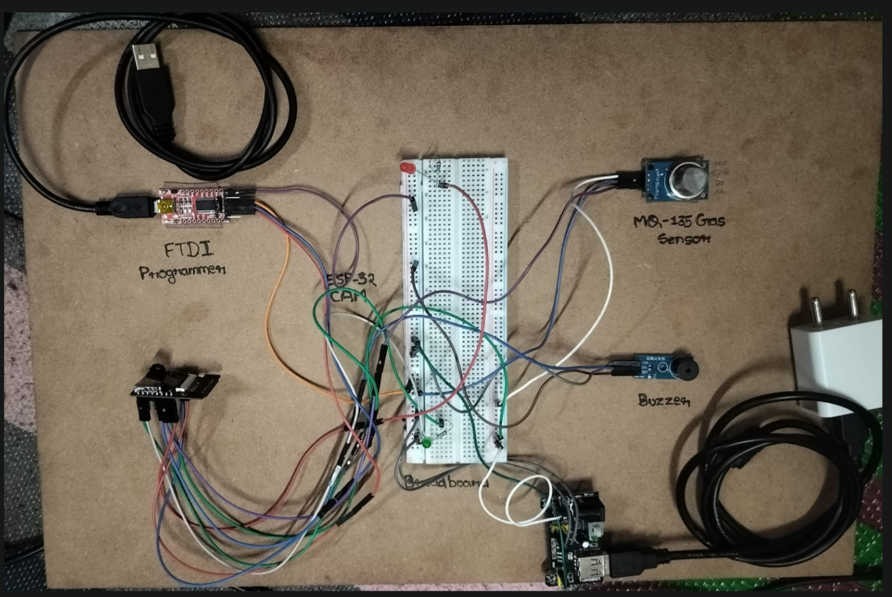
HARDWARE IMPLEMENTATION
01
FTDI Programmer
Connected to ESP32-CAM IO0→GND for flash mode.
TX→RX, RX→TX cross-connected.
02
MQ-135 Wiring
VCC→5V, GND→GND, AOUT→GPIO14 (ADC pin)
on ESP32-CAM.
03
LED Connections
Red LED → GPIO4 via 220Ω resistor. Green LED → GPIO2
via 220Ω resistor.
04
Buzzer Wiring
Active buzzer positive → GPIO13, negative → GND.
05
Power & Ground
ESP32-CAM powered at 5V via FTDI. All GND rails
tied together on breadboard.
Circuit Prototype

Slide 10
SOFTWARE COMPONENTS
IDE & Programming
AI / ML Framework
▸ Arduino IDE 2.30.80 — used for ESP32-CAM programming
▸ TensorFlow / Keras — used for conceptual understanding of image classification (THESE ARE PYTHON LIBRARIES)
▸ Python 3.10.11 — CNN model training & conversion NOTE:-(SPECIFIC MODEL-Binary compatibility-precompiled software works only with specific versions of Python and system architecture. If the versions match, the program runs without errors; otherwise, it fails)
Dataset & Training
Hardware Libraries
▸
Kaggle Moldy Bread Dataset — used for conceptual understanding
80% of dataset- training
20% of dataset-training
15 epochs
▸ esp_camera.h — image capture from ESP32-CAM
▸ Arduino analogRead() — MQ135 gas sensor reading
▸ digitalWrite() — LED and buzzer control

Slide 11
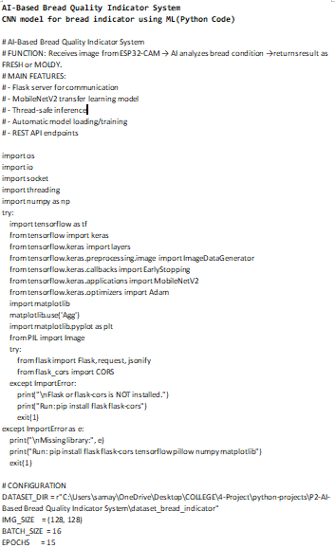
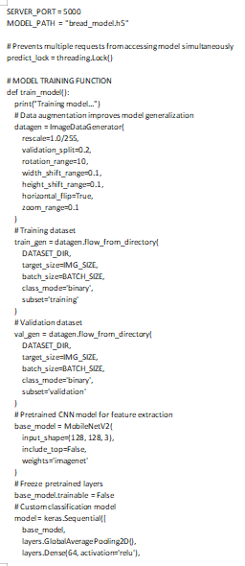
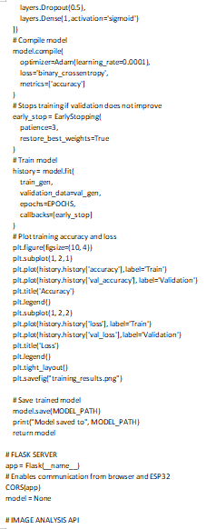
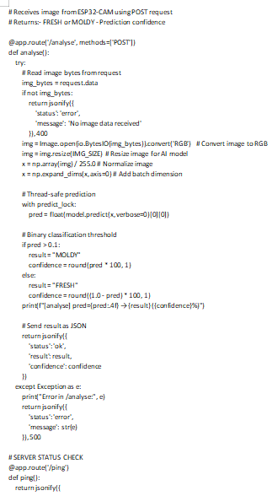
CNN model for bread indicator using ML(Python Code)

Slide 12
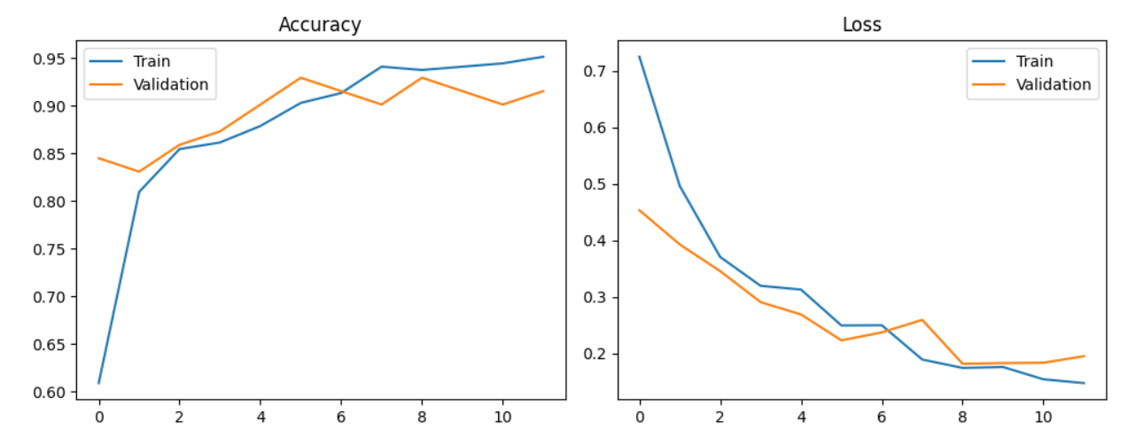
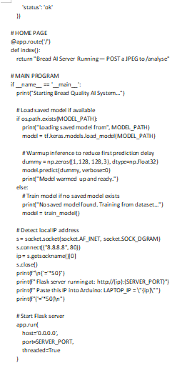
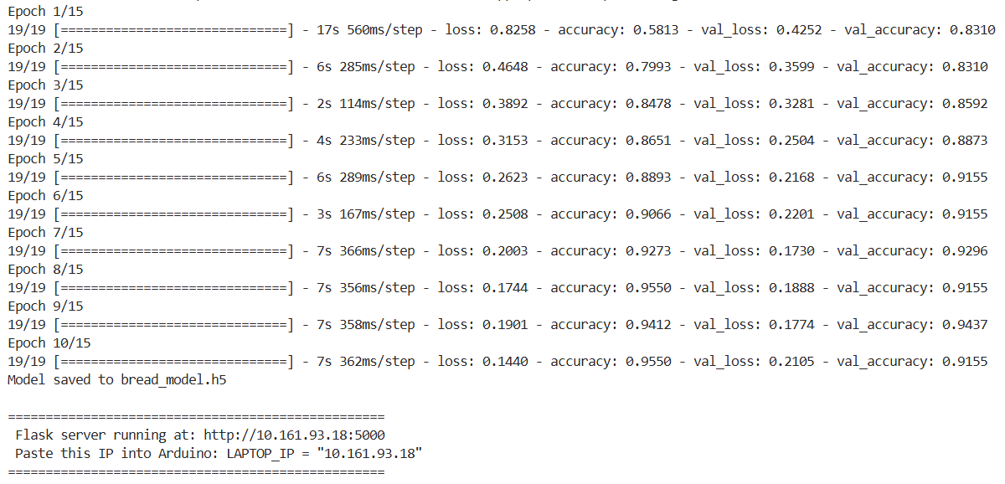
CNN model for bread indicator using ML(Python Code)

Slide 13
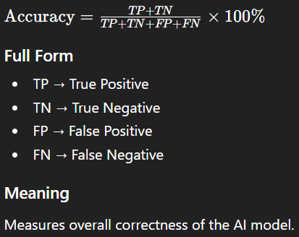
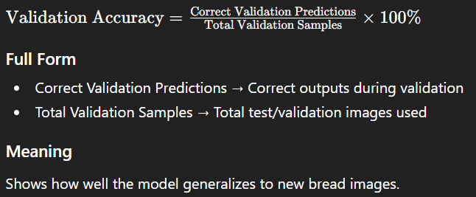
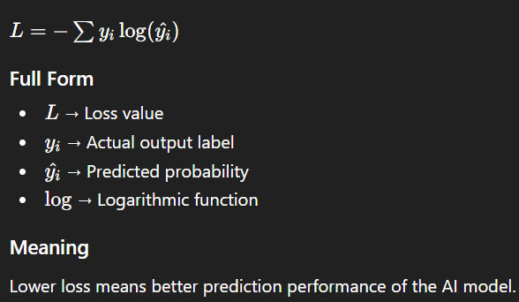
CNN model for bread indicator using ML(Formula’s using in the Python Code)

Slide 14
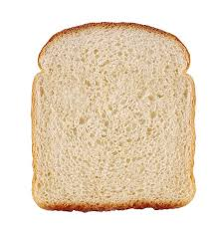
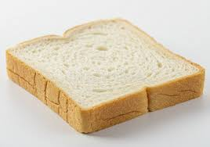
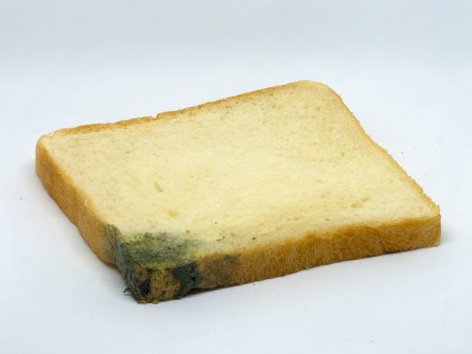
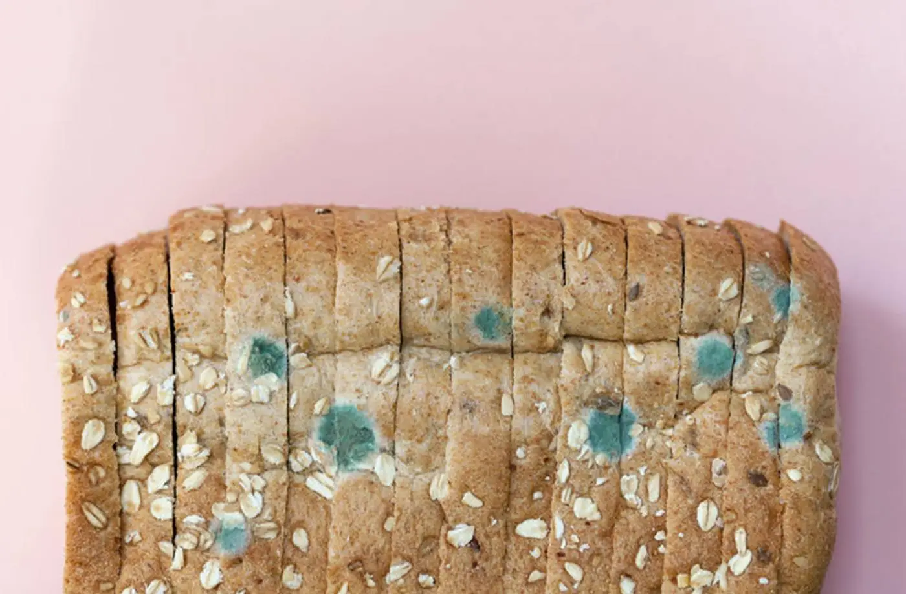
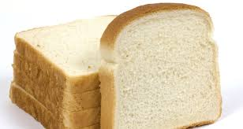
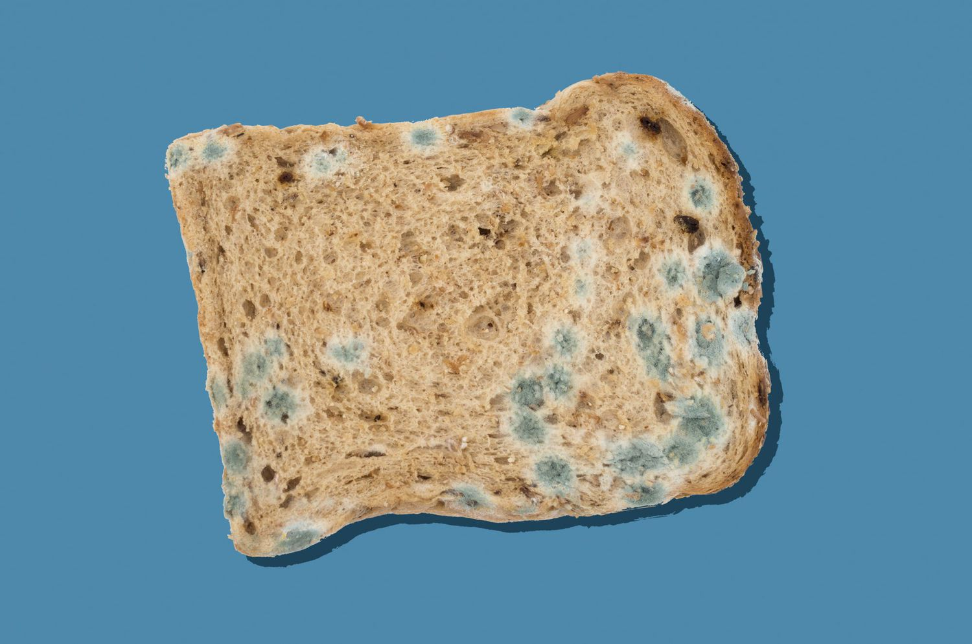
SOFTWARE IMPLEMENTATION — [Dataset & Image Analysis (Reference for AI Training)]
Fresh Bread (Reference Samples)
Moldy Bread (Reference Samples)
These images are used to understand visual differences between fresh and moldy bread and for future AI-based detection.

Slide 15
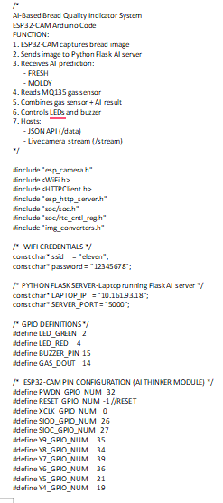
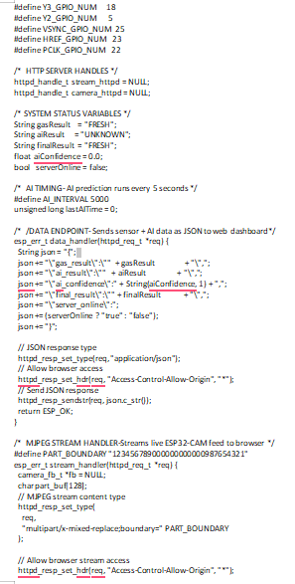
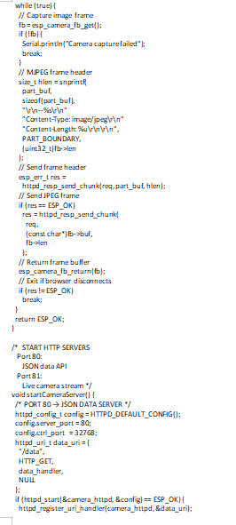
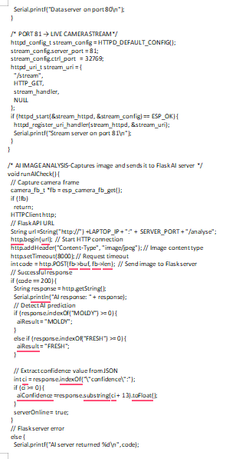
Arduino Code for ESP32-CAM

Slide 16
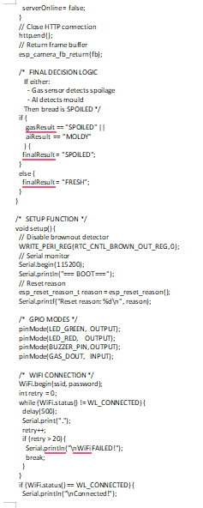
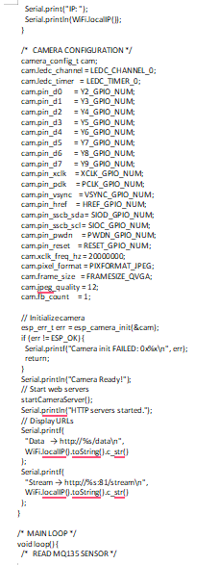
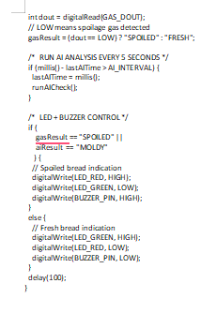
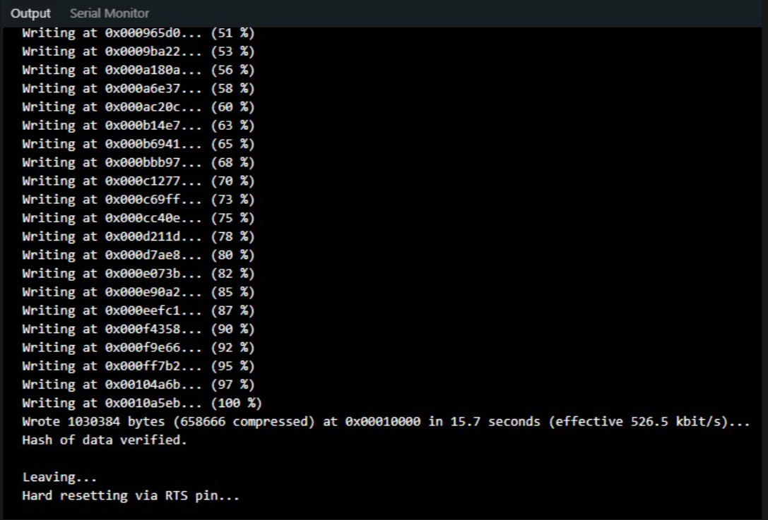
Arduino Code for ESP32-CAM

Slide 17
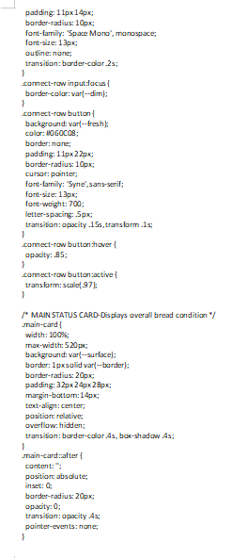
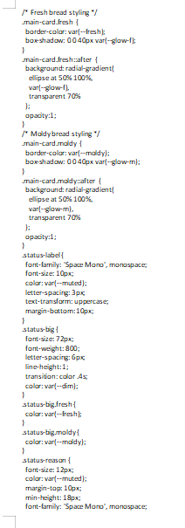
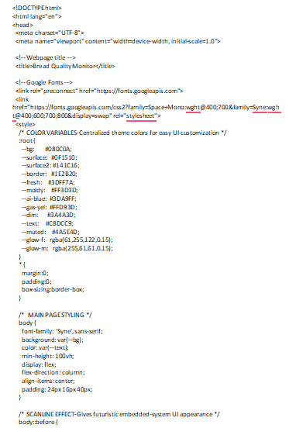
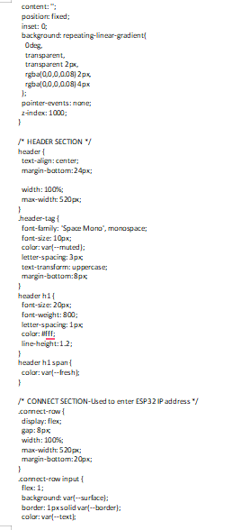
Web App Code

Slide 18
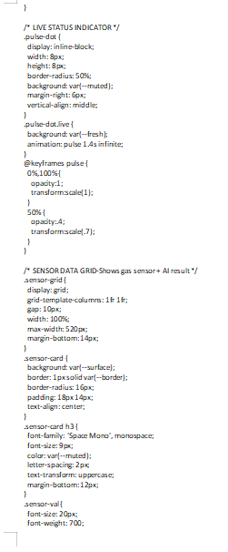
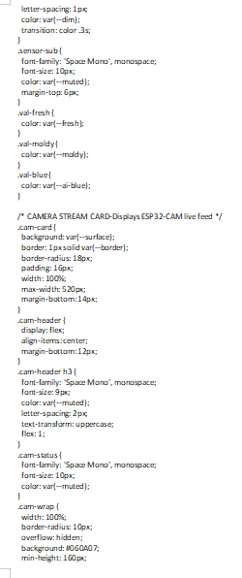
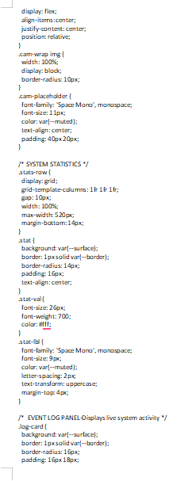
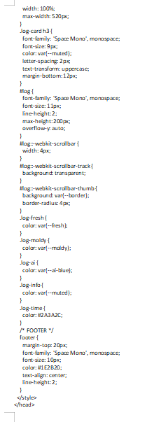
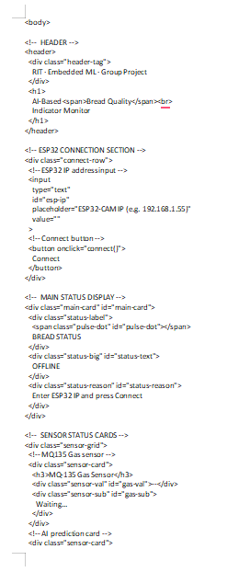
Web App Code

Slide 19
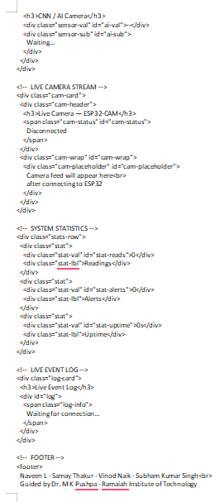
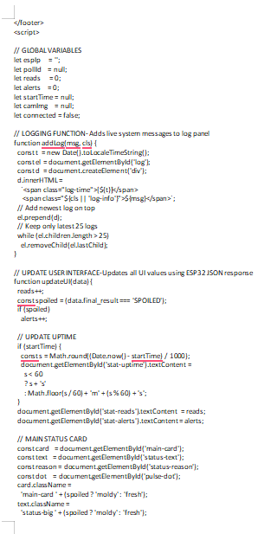
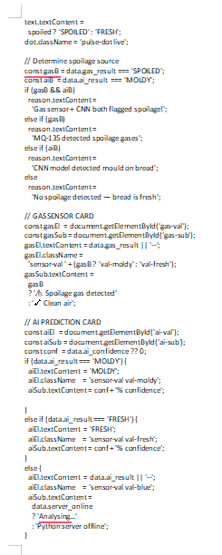
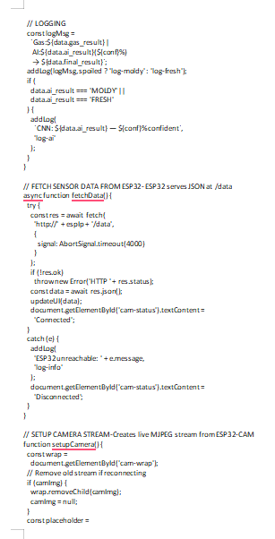
Web App Code

Slide 20
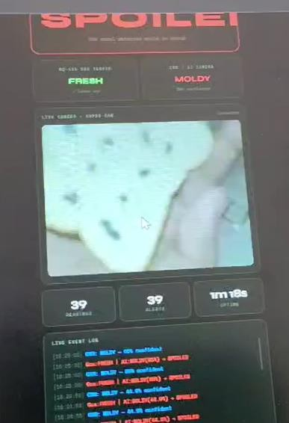
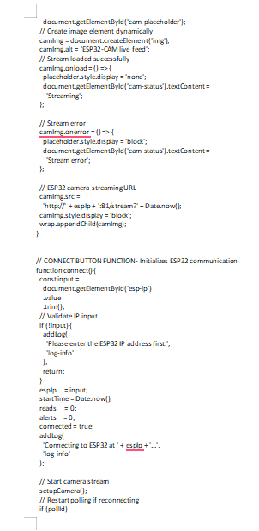

Web App Code

Slide 21

RESULTS
Python Code:-
giving dataset(fresh and mold) -> generate graph and ip address

Slide 22

RESULTS
Arduino Code:-
code installed in ESP32-CAM -> generates ip address of arduino
python model and arduino code is connected through laptop ip address

Slide 23

RESULTS
RESULTS
Web App:-
putting ip address of arduino to run -> check whether bread is fresh or mold by analysing image

Slide 24
CONCLUSION
01
The system detects bread quality using MQ135 gas sensor based on threshold values.
02
Gas sensor readings increase with bread spoilage, enabling effective detection.
03
The system provides real-time alerts using LED and buzzer indicators.
04
The implementation is low-cost and suitable for practical applications.
05
Reference image analysis is included for conceptual understanding of AI-based detection.
06
Future work includes integration of image-based AI models and IoT-based monitoring.
Ramaiah Institute of Technology | Dept. of Electronics & Instrumentation Engineering | 2025–26

Slide 25
AI-Based Bread Quality Indicator System
Samay Thakur(EI044) | Vinod Naik(EI404) | Naveen L(EI034) | Subham Kumar Singh(E1053)
THANK YOU

